Slide 1
FJA Start Time and Schedule

Slide 2
Purpose
Review current research and issues regarding school start time
Discuss possible changes to the FJA schedule
Gather input from staff/students/parents

Slide 3
School Start Time

Slide 4
“Sleep is the most effective cognitive enhancer we have.”
--Dr. Russell Foster, Oxford University

Slide 5
What Adolescent Sleep Studies Say
Adolescents need 8 hours of sleep (at least)
Middle and high schools should (according to studies) start no earlier than 8:30 AM
Less than 17% of middle and high schools in the United States/Canada start at 8:30 AM or later

Slide 6
Why Look at This?
Studies show that with later start/more sleep there are:
Increases in student achievement (Colby)
Fewer unplanned/unexcused absences/tardies (UM study)
Fewer sports related injuries (Los Angeles study)
Fewer teen automobile accidents (CDC Study)
Less alcohol/drug use among teens (Journal of Youth and Adolescence)
Lower rates of depression and suicide amongst teens (Journal of Youth and Adolescence)

Slide 7
Why Look at This (cont.)
School attendance matters
When students are in school they do better (government funded study)
Student achievement increases the most for the lowest achieving quadrant (Colby College study)
A one-hour delay in start times increased math and reading scores (Colby)
A one-hour change is the equivalent of shrinking class size by one-third

Slide 8
Seattle/University of Washington Study
Starting in the 2016-2017 school year, all Seattle middle and high schools moved from 7:50 to 8:45 start times.
Researchers from the University of Washington found that the 55 minutes in later start time meant, on average, 34 more minutes of sleep for all students. Meaning they went from 6:50 minutes to 7:24 minutes of sleep.
In one large group that was studied, a nearly 5% improvement was shown in overall student grades in biology when looking at all factors remaining equal.
Many more kids engage in the process of their education and far fewer have unexcused absences and tardies.

Slide 9
Who Endorses A Later Start Time
Centers for Disease Control
American Medical Association
American Academy of Pediatrics
American Psychological Association
American School Health Association
Society of Pediatric Nurses
National Association of School Nurses
National Education Association

Slide 10
Why Not Change?
Scheduling
Busing
Athletics
Adult convenience
Day care
Student Employment
Tradition/It is What We’ve Always Done

Slide 11
Schedule

Slide 12
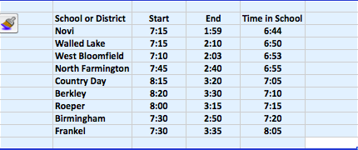
Length of School Day

Slide 13
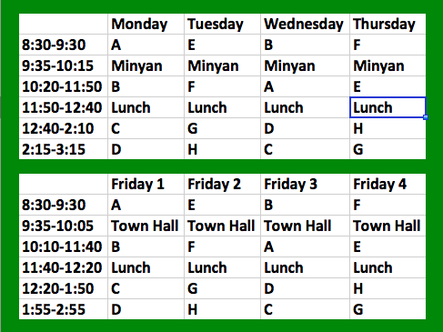
Schedule

Slide 14
What Does This Schedule Do?
Allows for later start time.
Aligns more closely with the middle school schedules our students are accustomed to.
Potentially allows for greater options in student scheduling.
Creates greater class equality.
Provides variation in both class meeting time and class length—not one size fits all.
Preserves number of classes and course selections.

Slide 15
Future Factors
Updated Course Sequence
Revised Graduation Requirements
Variety of Course Offerings
Cross-Curricular Opportunities
Increased Student Choice

Slide 16
Questions/Ideas

